Slide 1
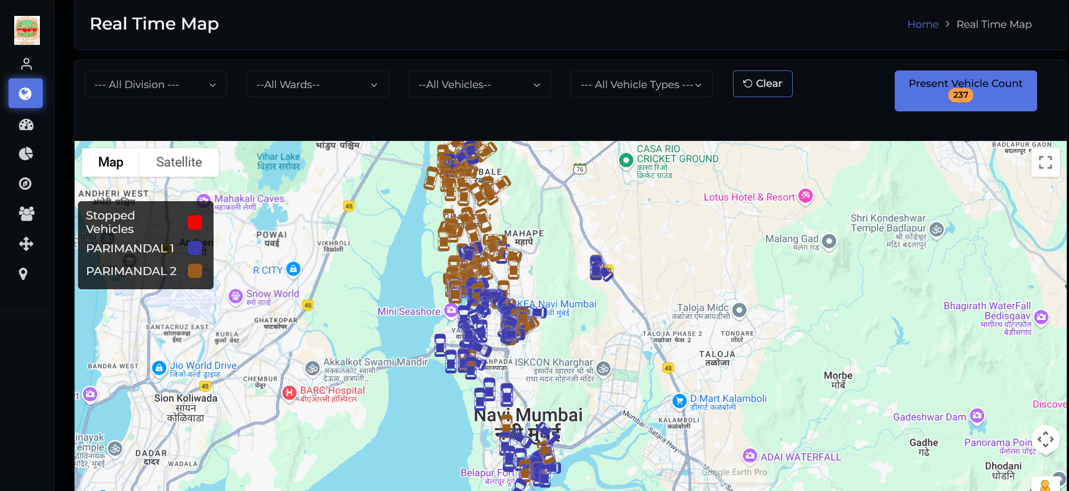
Review Report on Solid Waste Management (SWM) Department Dashboard
Vehicle Tracking System Dashboard

Slide 2
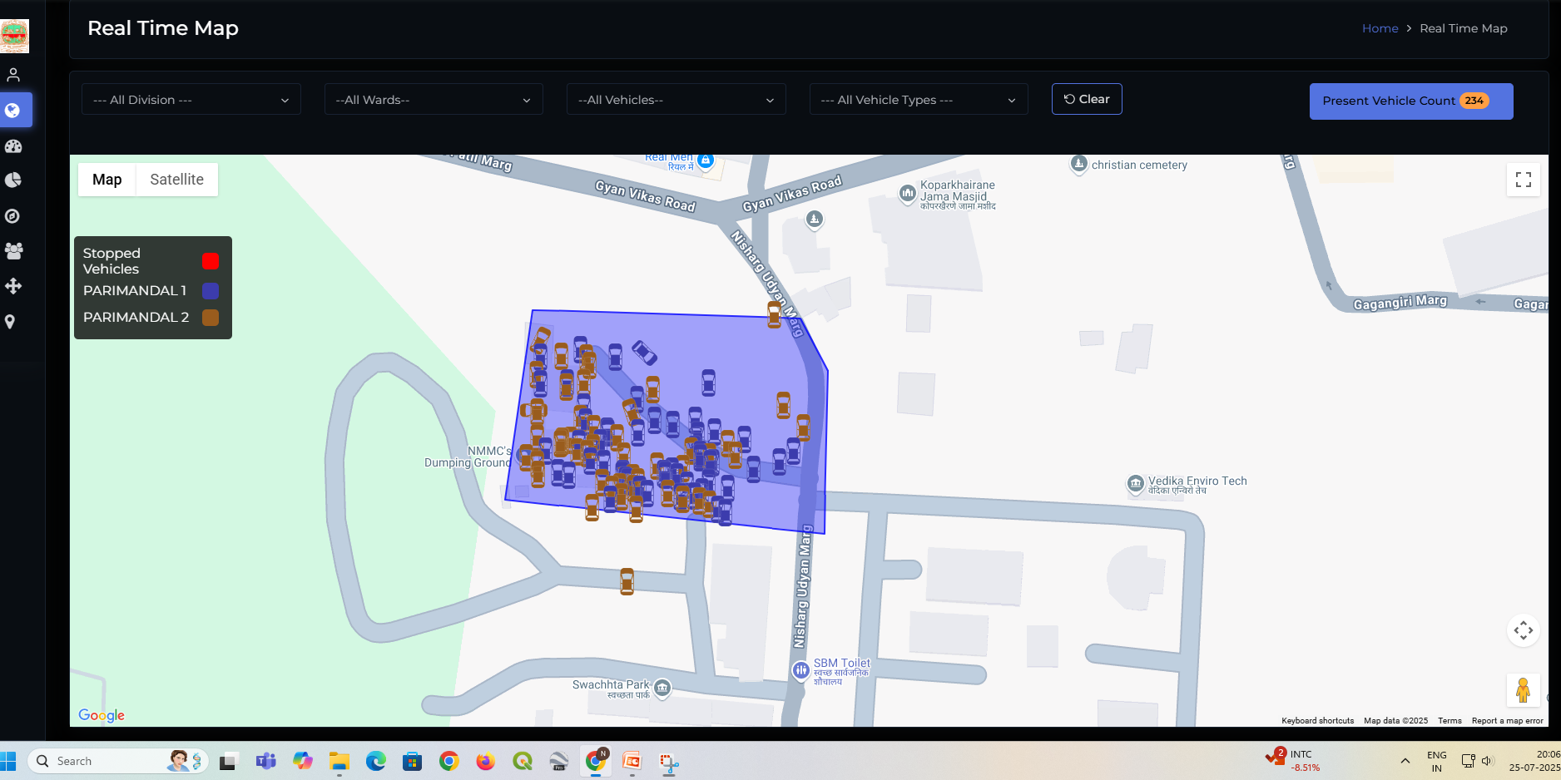
Not Functional

Slide 3
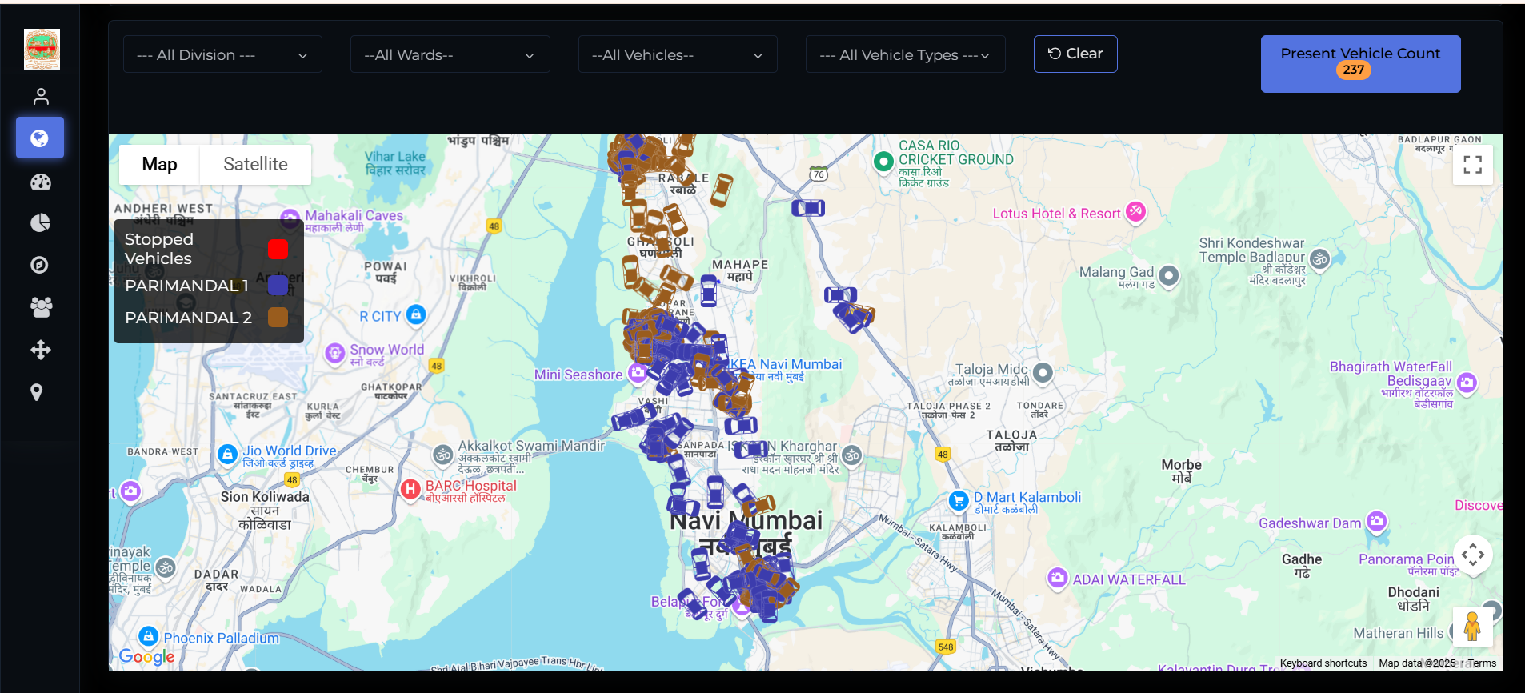
Observation 1
Not Functional

Slide 4
Observation 1:
On the main Google Map-based geospatial dashboard, vehicle markers are currently shown in:
Red for stopped vehicles,
Blue for Pari Mandal 1 vehicles, and
Brown for Pari Mandal 2 vehicles.
However, the system does not reflect the red status color when vehicles are stopped or parked at designated areas (e.g., depots, transfer stations, or after shift completion). This results in a misleading representation of real-time vehicle activity and status on the` dashboard.
Recommendations:
1. Enhance Real-Time Vehicle Status Visualization:
Integrate dynamic GPS telemetry to capture and reflect real-time movement vs idle state.
Ensure that stopped or parked vehicles—especially those that remain stationary beyond a configurable threshold (e.g., 15 minutes)—are automatically flagged in red.
This helps supervisors identify inactive or off-duty vehicles at a glance.
2. Define and Display 'Parking Zones':
Mark designated parking areas or depots on the map using transparent polygons or icons.
When a vehicle is inside a recognized parking zone after duty hours, show a different red shade or use a "P" symbol overlay to distinguish “Stopped in Parking” from “Stopped Unexpectedly.”
3. Enable Time-Based Color Transitions:
Implement time thresholds for color coding:
<5 min idle → remain blue/brown (on route)
5–15 min idle → light orange (possibly delayed)
>15 min idle or at depot → solid red (stopped)
4. Add Tooltip or Info Card on Click:
When users click on a vehicle icon, show an info card:
Last GPS location time
Speed = 0 km/h
Current status (e.g., “Idle at Sector 15 Depot”)
Shift status (Active/Completed)
5. Map Legend Enhancement:
Clearly define what each color and symbol means in the legend.
Make sure the legend updates dynamically based on time-of-day and shift logic.

Slide 5
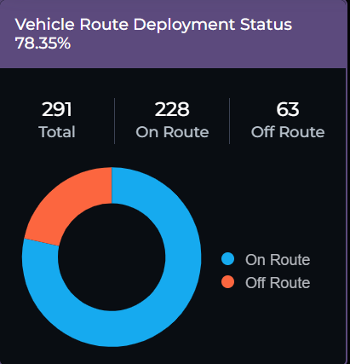
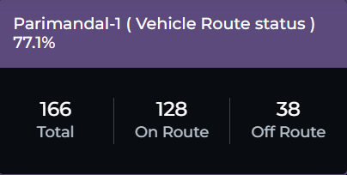
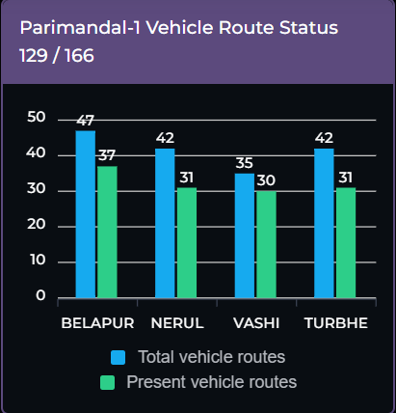
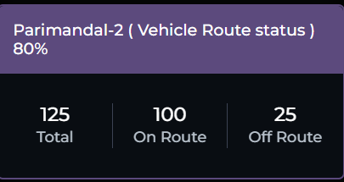
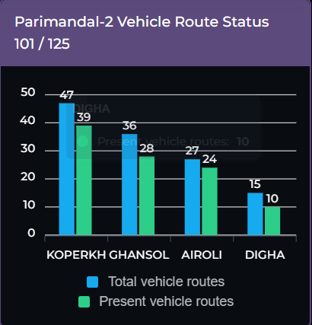
Observation 2
Observation 2.1
Observation 2.2
Observation 2.4
Observation 2.3

Slide 6
Observation 2 (1/2)
Observation 2.1:
The main dashboard displays the total number of vehicles that are On Route and Off Route out of the total vehicles assigned for SWM tasks.
This view is high-level but lacks geospatial drill-down capability.
Recommendations 2.1:
1. Unified Hierarchical Drill-Down Visualization
Implement a layered, map-based dashboard where users can start from a city-wide view and drill down progressively:
Level 1: NMMC-wide summary (Total Vehicles – On Route / Off Route) with Geospatial Mapping and same color coding.
Level 2: By Pari Mandal (1 & 2) with zone-wise color coding as same as assigned to vehicles on Geospatial Maps.
Level 3: Geospatial level Analysis by Admin Ward within each Pari Mandal
Level 4: Click on a ward to view individual vehicles, their exact real-time locations, and status indicators and same would be reflected in the Geospatial Map and these features should be on single View Page/platform of Dashboard
2. Enable Route Coverage Visualization:
Overlay the intended routes on the map and highlight if a vehicle deviates or does not cover its assigned area.
This will help in identifying missed collections or route violations.
3. Time-based Filters:
Add filters to show vehicle status shift-wise (First Shift, Second Shift, Last Shift with time lines), so that analysis is time-specific.
4. Vehicle Utilization Summary Cards:
Include summary cards or widgets showing:
Total Vehicles
Vehicles On Route (%) (option to view the same in numbers)
Vehicles Off Route (%) (option to view the same in numbers)
Active vs. Inactive Routes

Slide 7
Observation 2 (2/2)
Observation 2.2:
Current Functionality: The dashboard shows On Route and Off Route vehicles segregated by Pari Mandal 1 and Pari Mandal 2 in a separate view.
Observation 2.3:
The dashboard displays On Route and Off Route vehicles by Admin Wards under each Pari Mandal. However:
There is no drill-down on a single interface, and
The legend terminology changes inconsistently (e.g., “Present Vehicles on Route”).
Recommendations 2.2:
Integrate Mandal-wise View into Single Unified Dashboard: Instead of navigating to a separate screen, allow the user to toggle between Pari Mandal 1- and 2-layers using checkboxes or dropdowns on the main map dashboard.
Color Coding by Mandal with Status Overlay: Use dual encoding: one color for mandal (e.g., Blue for Mandal 1, Brown for Mandal 2), and icon fill color (Green for On Route, Red for Off Route).
Legends & Labels: Ensure consistent labeling such as:
“Pari Mandal 1 – On Route”
“Pari Mandal 2 – Off Route”
Avoid label ambiguity that may confuse dashboard users.
Pari Mandals on Map: Clearly draw and label Pari Mandal boundaries on the map for spatial understanding.
When a specific active route is clicked, it should show:
Route Name
Vehicle currently operating on the route
Recommendations 2.3:
1. Enable Drill-down on the Map Itself:
Clicking on a Pari Mandal should zoom into its Admin Wards, and clicking on a ward should show the list of vehicles and their current status.
2. Standardize Legend Naming:
Maintain a uniform terminology across all layers:✅ “Vehicles On Route”❌ Avoid variations like “Present Vehicles on Route”. Place the legend in a fixed position on the map for consistency. Legend should be same for On Route and Off Route on Maps and Visualization Dashboard.
3. Dynamic Vehicle Clustering & Heatmap:
Use vehicle clustering in high-density zones. Introduce a heatmap view for route coverage vs. no-coverage areas.
4. Add Ward-Level Performance Metrics:
Display KPIs such as: Number of vehicles per wardRoute coverage %Collection status (Completed / Pending)Visualize using bar graphs or ward-wise cards on the same dashboard.

Slide 8
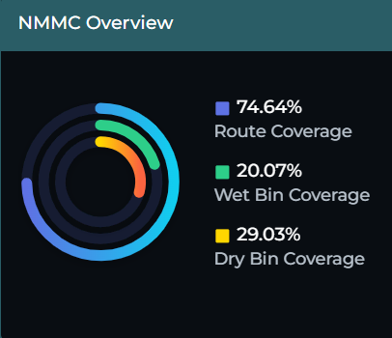
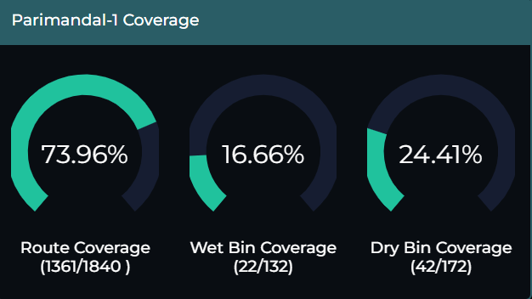
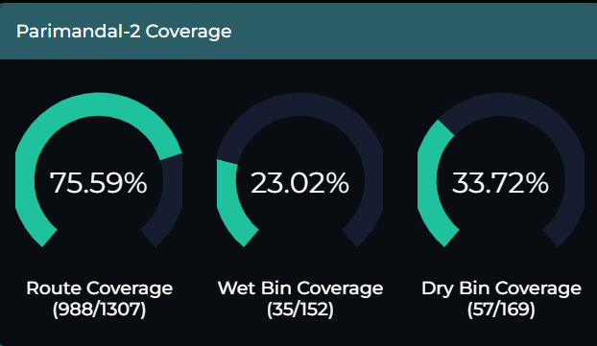
Observation 3
Observation 3.1
Observation 3.2
Observation 3.3

Slide 9
Observation 3 (1/2)
3.1. NMMC-Wide Overview
Displays:
Route Coverage
Wet Bin Coverage
Dry Bin Coverage
3.2. Parimandal-1 Coverage
Same parameters: Route, Wet Bin, Dry Bin Coverage Legend has not matched with first “NMMC Overview”
3.3. Parimandal-2 Coverage
Same parameters: Route, Wet Bin, Dry Bin Coverage. Legend has not matched with first “NMMC Overview”
Major Gaps Identified
Legend is not matched or not aligned with the colors showing in the Visualization tab parts in “NMMC Overview”.
These visualizations are not geospatially integrated (i.e., no live map layers).
No interactive drill-down (from NMMC to Mandal → Ward → Vehicle/Bin level).
Routes and bins are not mapped precisely, risking missed coverage.
No point data mapping of WPP (Waste Processing Points) with attributes.
Vehicle activity status is not visually linked to bin or WPP locations.
Map does not show multiple features side-by-side, reducing operational clarity.
Legend colors of “NMMC Overview” part has not matched with “PariMandal 1 & 2 Coverage”

Slide 10
Observation 3 (2/2)
3.1. Recommendations
1. Use of GIS Layered Dashboard:
Display NMMC Boundary base map of NMMC with:
Routes as polylines
Bin locations (wet & dry) as point layers
WPPs as facility points with Ward Boundaries
2. Add Route Coverage Layer:
i. Route coverage lines should highlight completed, pending, and missed segments using different colors:
Green – Covered
Orange – Partial
Red – Missed
3. Overlay Wet & Dry Bin Locations:
i. Use two separate symbols or icons:
Blue dot for Wet Bin
Yellow dot for Dry Bin
4. Integrate WPP Layer:
Show WPP locations as labeled facility icons.
ii. On click, display attributes like:
Total bins assigned to this WPP
Number of bins actually covered
Number of vehicles assigned
3.2. & 3.3. Recommendations
Parimandal-1 and Parimandal-2 Drill-Down Views
1. Enable Drill-Down by Admin Ward within Each Mandal:
Users should be able to click on Mandal → Ward → See Bin + Vehicle Details.
2. Color-Coded Vehicle Status by Route in Map View:
Vehicles operating on the route should highlight with a dynamic color:
Green – On Time
Red – Delayed/Idle
Grey – Completed Shift
3. Interactive Dashboard Cards:
Show statistics on the side:
Total bins in Mandal
Wet vs Dry bin distribution
Coverage percentage
Number of active vehicles
4. WPP Drill-Down Info:
Click on a WPP icon should display:
Ward-wise bin distribution
Assigned vehicle IDs and shift times
Route map lines starting/ending at the WPP
Note: (SI can choose color coding as per their choice but sdould be consistence for all Components of Platform)

Slide 11
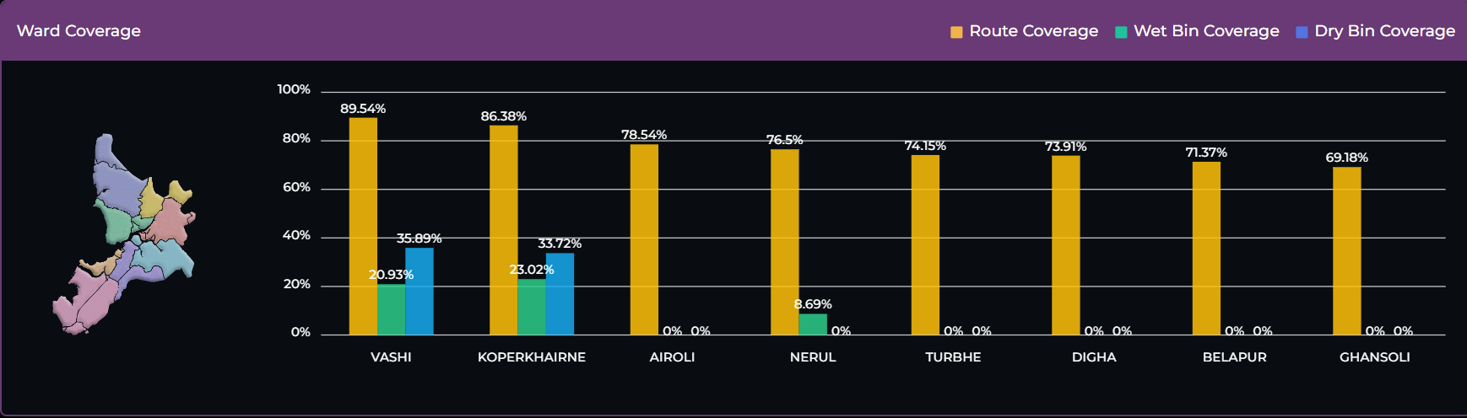
Observation 4

Slide 12
Observation 4 (1/2)
Observation 4 and Gaps:
Ward-wise bar graphs of:
Route Coverage
Wet Bin Coverage
Dry Bin Coverage
Each type has its own color-coded legend, but the color scheme differs from other parts of the dashboard.
2. Issues Identified:
Clicking on a specific bar (e.g., Route Coverage – Yellow) displays all categories' data (Route, Wet, Dry) instead of just the selected one.
Legends are inconsistent with the rest of the dashboard (Observation 3, 2, 1).
There is no control over the timeline visibility or interaction.
No direct data linkage from bars to relevant datasets or drill-downs.
1. Legend Consistency and Standardization
✅ Recommendation:
Use uniform legend colors across all dashboard components:
Green – Route Coverage
Blue – Wet Bin Coverage
Yellow – Dry Bin Coverage
II. Define and display these legends at a fixed and prominent location.
III. Update the legend dynamically only when new data layers are added.
2. Interactive Bar Chart Behavior
✅ Recommendation:
I. Ensure single-category responsiveness:
Clicking on Route Coverage (Yellow bar) must show only route-specific data (e.g., vehicle list, covered routes, missed segments).
It should not auto-trigger Wet or Dry Bin data unless manually selected.
II. Enable independent bar interaction:
Each bar (Route, Wet Bin, Dry Bin) should be clickable individually.
Once clicked, it should open a new side panel or modal popup showing relevant:
Summary statistics
List of affected wards or bins
Related GIS map snapshot (optional)

Slide 13
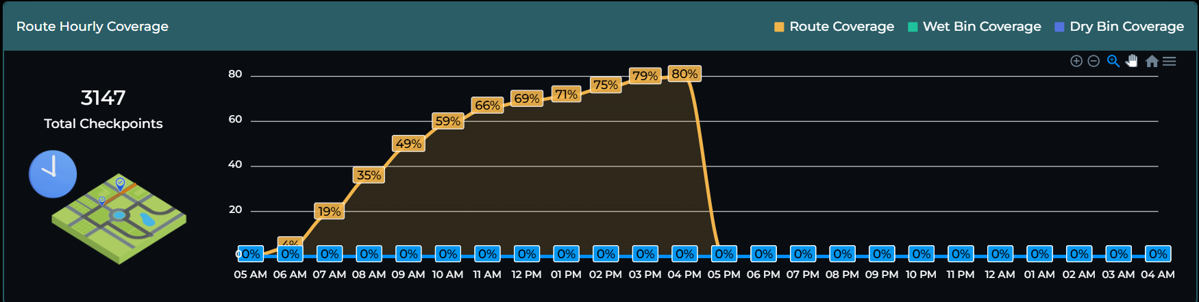
Observation 5

Slide 14
Observation 5
Observations and Gaps:
The dashboard currently shows:
Ward-wise bar graphs for:
Route Coverage
Wet Bin Coverage
Dry Bin Coverage
Each bar is color-coded, but the legend format is inconsistent with previous visualizations.
The dashboard is intended to reflect hourly performance, but:
No justification or supporting data is presented for metrics like “10% work completed from 5 AM to 6 AM.”
Users are unable to verify which routes or wards contribute to the calculated percentage.
Incomplete Work Justification:
No proof or source to verify how 10% or 59% completion was calculated.
No link to route names, ward names, or bin counts that were actually covered.
Missing Drill-Down Capability:
Users cannot click and explore deeper levels (e.g., from % to wards to routes).
Visual Inconsistency:
Legend colors differ from previous graphs.
Heading fonts and styles are not standardized.

Slide 15
Observation 5 (1/2)
Incomplete Hourly Performance Justification
✅ Recommendation:
I. Link Percentage to Proof of Completion:
Create a back-end data reference (preferably Excel or tabular database) that supports the visual data.
The reference should include:
Date & time of bin pickup
Route ID / Route name
Ward name
Type of bin (Wet/Dry)
GPS-tagged status (Covered/Not Covered)
II. Enable Route-Wise Performance Tables:
Provide a downloadable table/spreadsheet that:
Lists all assigned routes per ward
Displays percentage coverage per route
Shows timestamp of completion
III. Validation Logic:
Define how “10% completed” is calculated.
Example: 10% = 5 out of 50 bins covered + 2 out of 10 routes marked completed by GPS.
Display this logic transparently on hover or in a side panel.
2. Drill-Down Functionality Enhancement
✅ Recommendation:
I. Interactive Drill-Down from Bar Graphs:
Clicking on a bar representing a ward should:
Expand to show list of routes within that ward.
Indicate how many routes have been completed (with timestamp or color).
II. Hierarchical View:
Use a 3-tier structure:
Level 1: Ward-level bar graph (as currently shown)
Level 2: Route-level progress per selected ward
Level 3: Bin-level data with exact location and coverage status (optional)
III. Dynamic Time Filtering:
Add a time slider or filter (hourly) to observe:
Which routes were covered during which time block.
What percentage of total work was completed in each time frame.

Slide 16
Observation 5 (2/2)
3. Dashboard Formatting & Design Consistency
✅ Recommendation:
I. Consistent Color Legends Across Visuals:
Use the same color scheme for:
Wet Bin: Blue
Dry Bin: Yellow
Route Coverage: Green
Reflect these in all graphs, maps, and charts.
II. Standardized Heading Style:
Apply the following formatting rules:
Font: Calibri or Segoe UI
Style: Bold, Font Size 16–18
Color: Dark blue or consistent with brand identity
Align all headings to the left with a uniform margin.
III. Add Tooltips and Legends on Graphs:
Hovering over a bar should show:
Total bins assigned
Total bins covered
Coverage percentage
Number of vehicles involved
Issue based Solutions | Outcome
Justification of % Work | Builds credibility and transparency
Drill-Down Enabled | Allows supervisors to track performance at micro-level
Visual Consistency | Enhances readability and user experience
Time-Based Breakdown | Supports shift monitoring and work audits

Slide 17
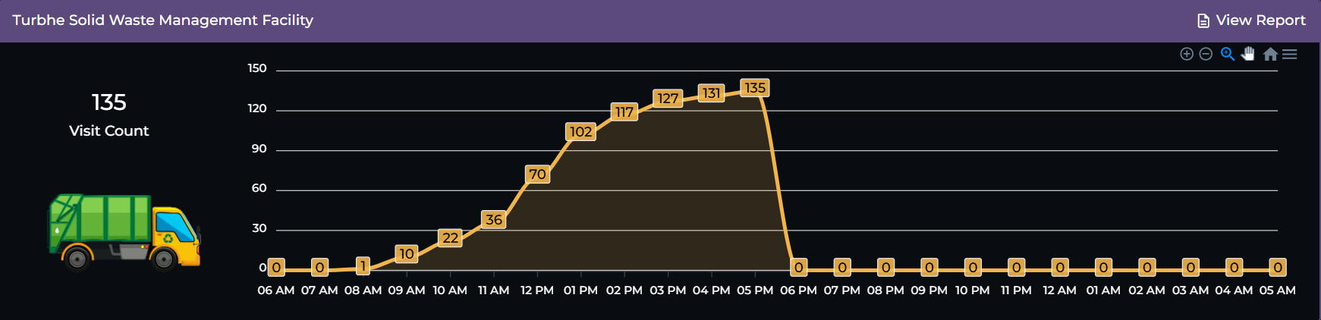
Observation 6

Slide 18
Observation 6
Observations and Gaps:
The dashboard currently shows:
The dashboard shows only cumulative hourly statistics of dumping ground visits.
This is a static numerical summary, lacking interactivity or vehicle-level insights.
Hourly visibility – Makes it easy to monitor shift-wise or real-time part performance
Gaps Identified
Lacks vehicle-wise drilldown, which is critical for operational monitoring.
Not linked to spatial or ward-level performance.
Misses load or weight data, which is key to measuring efficiency.
Not user-friendly for supervisors who need real-time actionable information.

Slide 19
Observation 6 (1/2)
Hourly Data View with Interactive Trend Graph
✅ Recommendation:
Replace simple cumulative numbers with a line or bar chart showing:
Hourly trend of dumping ground visits.
Split by vehicle type (Primary collection / Secondary collection).
Optional filter: By ward, Pari Mandal, or shift.
XY names of the visualization is must.
Benefits:
Quickly identifies peak hours of activity.
Allows performance comparison across shifts and wards.
3. Integrate GPS Route History and Verification
✅ Recommendation:
For each listed vehicle:
Geospatial Map Integration is essential
Provide a button to view route history on map (from WPP to dumping ground).
Color code path as:
Green (valid and complete route)
Red (missing segments or skipped bins)
4. Add Weight Analytics and Load Efficiency
✅ Recommendation:
1. Show total and average load weight per vehicle and per ward.
Identify:
Underutilized vehicles (e.g., low load but full route)
Overloaded trips (exceeding vehicle capacity) – If any
Add alert for unusual weight patterns.
2. Sample KPIs to display:
Avg. weight per trip
Max weight carried today
% of vehicles running under 60% capacity
2. Vehicle-Level Drilldown on Click (Drill Down)
✅ Recommendation:
When a user clicks on any value (e.g., “115 visits at 11:00 AM”), the dashboard should open a popup or drilldown table showing:
Vehicle Registration Number
Associated Ward
WPP (Waste Processing Point)
Name (if applicable)
Weight Carried (in tonnes or kg)
Time of entry and exit at dumping ground
Driver name (if available)

Slide 20
Observation 6 (2/2)
5. Dashboard Filters for Better Navigation
✅ Recommendation:
Enable filters such as:
Dumping Ground Location (if multiple)
Date & Time Range
Vehicle Type / ID
Shift (Morning, Afternoon, Night)
Ward or Admin Zone
6. Exportable Reports & Auto Summary
✅ Recommendation:
Allow users to download vehicle-wise dumping summary in Excel or PDF format.
Add a “Daily Summary Snapshot” showing:
Total trips completed
Total tonnage dumped
Average load per vehicle
Number of trips delayed or idle over 30 mins
Benefits
BI Objective | Dashboard Enhancement
Operational Transparency | Identify each vehicle’s contribution at the dumping ground
Efficiency Monitoring | Compare trip count vs load weight across zones
Route Validation | Detect skipped bins or inefficient trips using route maps
Performance Alerts | Get notified of underused or overused vehicles
Data-Driven Planning | Optimize number of trips and timings per ward based on actual load trends

Slide 21
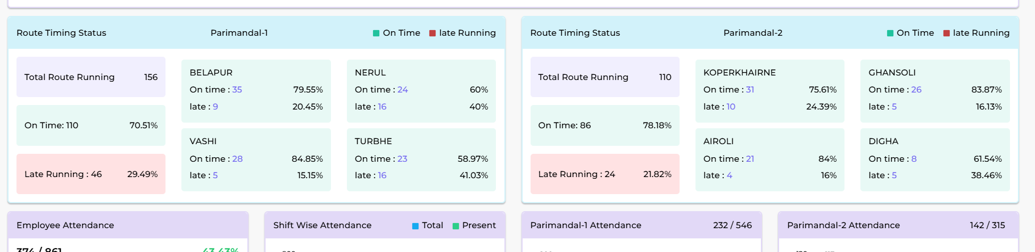
Observation 7
Observations and Gaps:
The dashboard shows card-based textual data for Solid Waste Management (SWM) vehicle tracking, with breakdowns by:
Pari Mandal
Admin Ward
Each card displays key metrics such as:
Total Route Running
On Route Running
Late Running

Slide 22
Observation 7
Visual Emphasis on Key Metrics
✅ Recommendation:
Use bold font and larger text size for primary KPIs:
Example: "On Route: 32 Vehicles“
Supporting text (e.g., “Out of 35 assigned”) should be in a lighter or smaller font, maintaining focus on the primary number.
4. Route Performance Indicators
✅ Recommendation:
I. Add a visual status bar or progress ring inside each card:
Shows % of route completed vs. assigned
Enhances instant readability and status assessment
Adopt Uniform Visualization tools
2. Color-Coded Highlights
✅ Recommendation:
I. Use colors to intuitively indicate performance status:
Green: On Route (Normal)
Orange: Late Running
Grey: Route Not Started or Inactive
II. Ensure that colors are consistent across all cards for quick interpretation.
5. Alerts and Flags for Late or Missed Routes
✅ Recommendation:
I. Include icon-based alert indicators:
🔴 Red icon for Late Route
🕒 Clock icon for routes not started
✅ Check mark for completed on-time routes
II. Hover-over tooltips can display reason for delay or last GPS timestamp.
3. Dynamic Card Layout Based on Hierarchy
✅ Recommendation:
Arrange cards in a top-down hierarchy:
NMMC → Pari Mandal 1 / 2 → Admin Ward Level
Use accordion-style collapsible sections if space is limited to reduce clutter while enabling drill-down.
6. Geo-Linked Interactivity
✅ Recommendation:
Make the cards clickable, so selecting a card zooms the main map to that ward or vehicle route.
This provides seamless integration between data and geography.

Slide 23
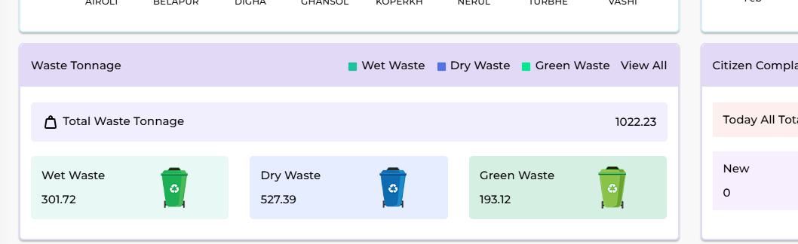
Observation 8
Recommendation 1:
Enable clickable features (bins, WPPs, routes, vehicles, wards, etc.) on the geospatial dashboard to display detailed reports in a pop-up panel or side pane. This will support deeper operational insights directly from the map interface.
Report Display Format: Use collapsible pop-up cards or a right-side sliding pane to show detailed reports.
Ensure real-time refresh for data fields like current vehicle location, last collection time, etc.
Recommendation 2:
1. Click on Bin Location (Wet/Dry Bin/Green Waste)
📋 Show Report Details:
Bin ID / UID
Bin Type (Wet/Dry/Green Waste)
Last Collection Time
Assigned Vehicle Number
Missed Collections (Last 7 Days)
Complaint status (if any)
Linked WPP or Transfer Station

Slide 24
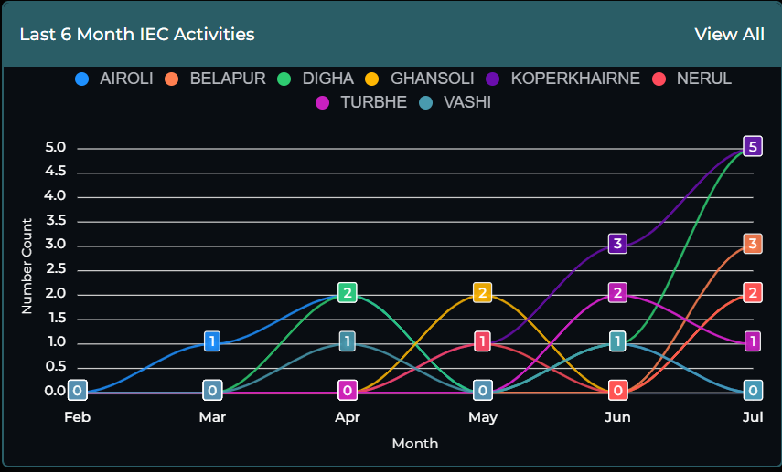
Observation 9

Slide 25
Observation 9
Observations 9 and Gaps: Visual & Legend Corrections Required
Identified Issues:
Current visuals do not align with the intended drill-down logic (e.g., clicking on "Airoli" shows data for all wards instead of just Airoli).
Legends are inconsistent or misleading—legend labels do not always match the data presented in the charts or maps.
This reduces user clarity and undermines confidence in the dashboard's accuracy.
Align Legends in Map-Based Views and Geospatial Integrated
✅ Recommendation:
Legends in geospatial views should reflect the layer being viewed:
Routes = line color legend (e.g., green = completed, red = missed)
Bins = dot color by type (e.g., wet/dry/overflowing)
Vehicles = icon color based on status (e.g., on-time/idle/delayed)
Display only relevant legends based on active layer or filter.
2. Align Legends in Map-Based Views
✅ Recommendation:
Each legend item must be dynamically linked to the correct data field in the backend.
Example: If the user clicks on Turbhe, only data for Turbhe should load across:
Charts, Tables, Maps and KPI Cards
3. Enable Interactive Legends
✅ Recommendation:
1. Clicking on a legend item should act as a filter:
For example, clicking “Pari Mandal 2” legend should display only its vehicles/routes/bins.
2. Tooltips should appear when hovering on a legend, showing:
Total value
% contribution
Last update timestamp

Slide 26
Urgent & Important (1/2) Some Important Points need to be incorporated as aim to strengthen monitoring, data interpretation, and accountability in NMMC's SWM operations.
1. 360° Camera Integration for Vehicle Monitoring
To enhance real-time field visibility, it is recommended to install 360-degree cameras on all SWM vehicles. These cameras should be configured to stream live feeds directly to the ICCC (Integrated Command and Control Centre) platform, ensuring comprehensive monitoring of on-ground collection and vehicle behavior. Each vehicle must be equipped with GPS-synced camera modules, allowing the ICCC operator to click on any vehicle from the dashboard map or vehicle list and instantly view its live video stream.
Additionally, the Coverage Dashboard should include a visual layer or icon for each vehicle, from where users can open the 360° camera feed in a side panel or new window. This feature not only increases operational transparency and supervisor visibility, but also supports video evidence-based audits for route deviation, collection lapses, or waste spillage. It is crucial to ensure that video data is stored for a minimum rolling period (e.g., 30 days) for compliance and review purposes.
2. Clock-Based Vehicle Timing Report
To improve operational punctuality and fleet discipline, a clock-based visual timing report should be introduced. This report would display a clock face (analog or radial format) showing the scheduled vs. actual arrival times of each vehicle at key locations such as WPPs, ward entry points, or bin clusters. If a vehicle is delayed—e.g., scheduled at 9:00 AM but arrived at 10:00 AM—the delay gap should be visually highlighted in red or orange on the clock interface, offering an instant visual cue for non-compliance.
This time-gap representation enables faster recognition of delayed or early arrivals, allowing shift supervisors or ICCC staff to take corrective actions in real time. Historical timing trends per vehicle can also be analyzed to identify recurring inefficiencies or behavioral patterns among specific drivers or routes.

Slide 27
Urgent & Important (2/2) Some Important Points need to be incorporated as aim to strengthen monitoring, data interpretation, and accountability in NMMC's SWM operations.
3. Wet & Dry Bin Data Overview
For more granular monitoring, the system should include a detailed list view of Wet and Dry Bin collection performance, mapped to their respective WPPs (Waste Processing Plants). This list should include: WPP Name, Associated societies or wards, Number of Wet/Dry bins assigned, collected, and pending, with visual collection status using color coding (e.g., Green = Collected, Red = Pending, Yellow = Partially Collected).
This overview allows real-time verification of bin-level collection completion across administrative zones. Moreover, by associating the WPP and society mapping, it supports route optimization, workforce allocation, and quick escalation in case of missed bins or repeated service gaps.
4. Auto Fine Tab
To drive accountability, an Auto Fine Tab should be implemented in the ICCC dashboard. This tab would use predefined violation rules (e.g., route skipped, late arrival, unauthorized stoppage) to automatically detect breaches via GPS and system logs. When a violation occurs, the system should: auto-calculate the fine as per set norms, log the timestamp, location, and type of violation, and associate the fine with the specific vehicle, driver, or route.
The Auto Fine Tab helps reduce human bias and enforces a data-backed penalty system, ensuring better compliance with SWM protocols. It can also serve as a deterrent mechanism to prevent operational negligence, thus improving service delivery standards.

